Slide 1
Unit 2 Number System
Lecture 2

Slide 2
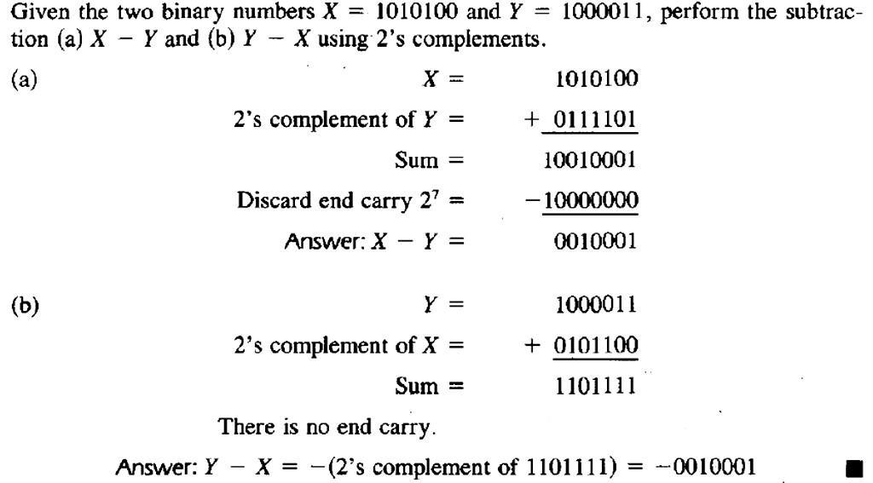
Example III

Slide 3
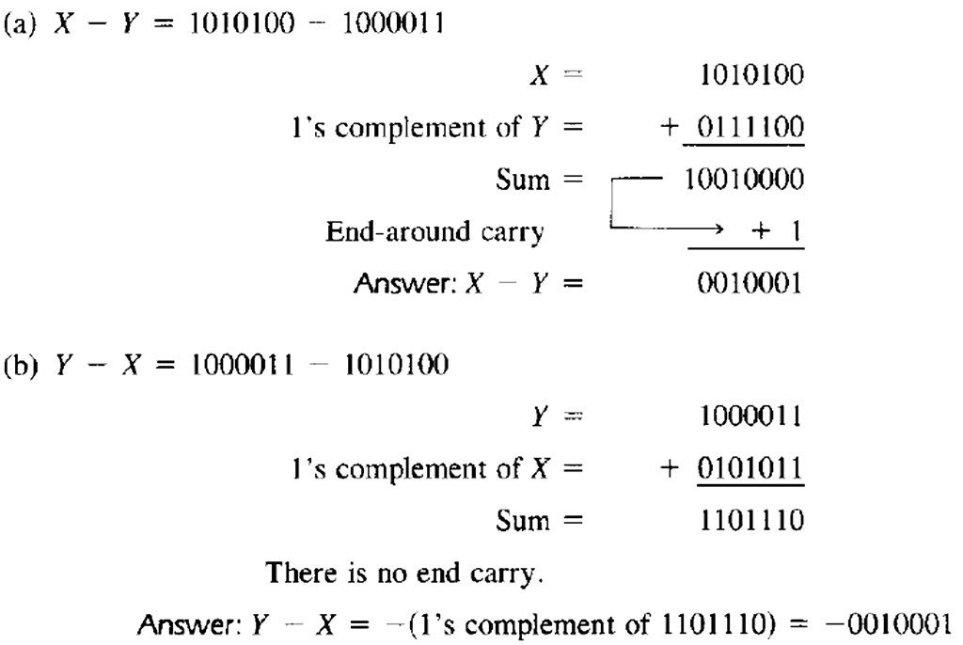
Example IV: Repeating Example III using 1’s complement.

Slide 4
#Perform the following Binary Subtraction using r’s and r-1’s complement :
1010 – 11011
1010-0101
10010-10101
11001-0101
1001-1101

Slide 5
Binary Codes
Electronic digital systems use signals that have two distinct values and circuit elements that have two stable states.
There is a direct analogy among binary signals, binary circuit elements, and binary digits. A binary number of n digits, for example, may be represented by n binary circuit elements, each having an output signal equivalent to a 0 or 1.
Digital systems represent and manipulate not only binary numbers, but also many other discrete elements of information.
Any discrete element of information distinct among a group of quantities can be represented by a binary code. Binary codes play an important role in digital computers.
The codes must be in binary because computers can only hold 1's and 0's.

Slide 6
1. Binary Coded Decimal (BCD)
The binary number system is the most natural system for a computer, but people are accustomed to the decimal system.
So, to resolve this difference, computer uses decimals in coded form which the hardware understands.
A binary code that distinguishes among 10 elements of decimal digits must contain at least four bits. Numerous different binary codes can be obtained by arranging four bits into 10 distinct combinations.
The code most commonly used for the decimal digits is the straightforward binary assignment listed in the table below. This is called binary-coded decimal and is commonly referred to as BCD

Slide 7
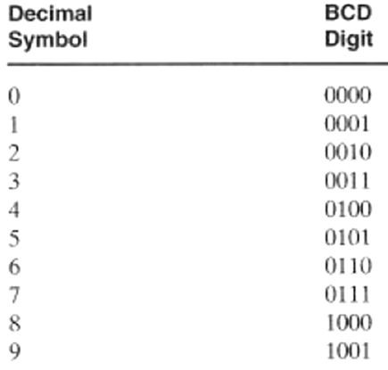

Slide 8
A number with n decimal digits will require 4n bits in BCD. E.g. decimal 396 is represented in BCD with 12 bits as 0011 1001 0110.
Numbers greater than 9 has a representation different from its equivalent binary number, even though both contain 1's and 0's.
Binary combinations 1010 through 1111 are not used and have no meaning in the BCD code.
Example:
(185)10 = (0001 1000 0101)BCD = (10111001)2

Slide 9
2. Error-Detection codes
Binary information can be transmitted from one location to another by electric wires or other communication medium.
Any external noise introduced into the physical communication medium may change some of the bits from 0 to 1 or vice versa.
The purpose of an error-detection code is to detect such bit-reversal errors.
One of the most common ways to achieve error detection is by means of a parity bit.
A parity bit is the extra bit included to make the total number of 1's in the resulting code word either even or odd.
A message of 4-bits and a parity bit P are shown in the table below:

Slide 10
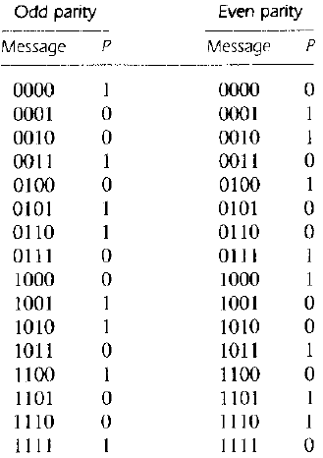

Slide 11
Error Checking Mechanism:
During the transmission of information from one location to another, an even parity bit is generated in the sending end for each message transmission.
The message, together with the parity bit, is transmitted to its destination. The parity of the received data is checked in the receiving end.
If the parity of the received information is not even, it means that at least one bit has changed value during the transmission.
This method detects one, three, or any odd combination of errors in each message that is transmitted. An even combination of errors is undetected.
Additional error- detection schemes may be needed to take care of an even combination of errors.

Slide 12
3 Gray code (Reflected code)
It is a binary coding scheme used to represent digits generated from a mechanical sensor that may be prone to error. Used in telegraphy in the late 1800s, and also known as "reflected binary code”.
In Gray code, there is only one bit location different between two successive values, which makes mechanical transitions from one digit to the next less error prone.
The following chart shows normal binary representations from 0 to 15 and the corresponding Gray code.

Slide 13
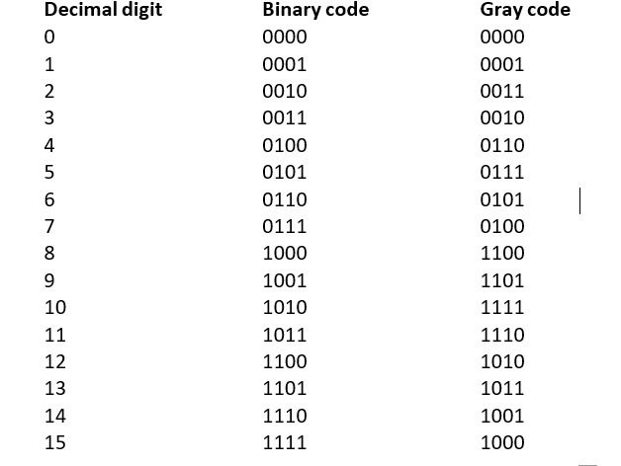

Slide 14
